Slide 1
Washing machine prototype

Slide 2
Content
Introduction
Equipment
Methodology
Safety Issues
Improvements

Slide 3
Introduction
This mini project explores the possibility of automating a traditional washing machine using an Arduino microcontroller. The goal is to replace the original control unit with a low-cost, user-programmable system based on Arduino. This exercise will provide students with insights into the system requirements, hardware components, and programming necessary for creating a simple device.
OBJECTIVES:
Learning Embedded Systems:
Understanding how to integrate and control various hardware components like motors, pumps, valves, and sensors using Arduino.
2. Programming Skills:
Enhancing programming skills to write and debug code for microcontroller-based applications.
Electronics Knowledge:
Gaining hands-on experience with electronic components, circuits, and wiring.

Slide 4
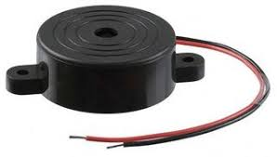
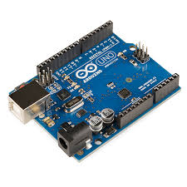
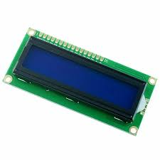
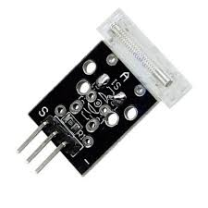
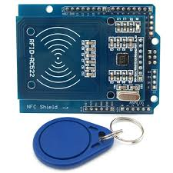
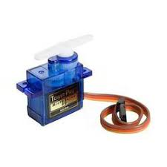
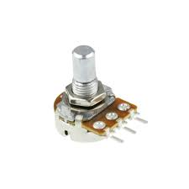
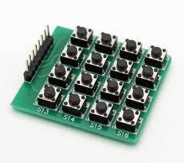
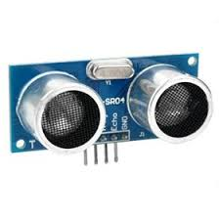
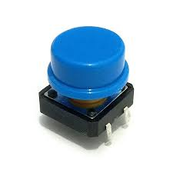
Equipment
Arduino
LCD display
Servo
Ultrasonic sensor
4x4 Multiplexing buttons
NFC reader
Tap module
Potentiometer
Pushbutton
Active piezo buzzer

Slide 5
Methodology
Power up the Arduino by connecting it to a power source.
Scan the tag on the RFID reader.
The LCD screen will ask user to load their clothes, however, for simulation purposes the there is a timer.
Press tap module which simulates the door closing.
Press on of the buttons to choose to start the washing cycle or the drying cycle.
The ultrasonic sensor will measure the amount of clothes in the washer and then choose an appropriate water and soap amount and the best time length for the washing and drying cycles.
After the cycles have stopped a tone will play and let the user know the washing and drying is done.
There is an extra feature on the machine which is a piano to entertain users.

Slide 6

Safety Issues
There is no feature to lock the door in this current prototype.
The outer drum of a washing machine should be held by a heavy-duty spring.
If machine starts shaking too much it will stop working.

Slide 7
Improvements
Adding a pump for a more realistic washer.
Using a stepper motor for the simulation is a better option compared to a servo motor.
A motion detector could be used to identify children and notify families.
A water heater valve which would heat the water being used to wash for better washing quality.
Adding a WIFI module to be able to monitor the washing machine in real time from different places.
Adding more washing and drying options for different kinds of clothes and materials.
Adding a vibration senor.
Using photoelectric sensors instead of ultrasonic sensors for better accuracy.

Slide 8
THANK YOU
Syeda Samia 2123536
Athirah Haziqah 2210240
Siti Heidi Amira 2111970

